Slide 1
Title of Project: Inflight Catering
Team Name: Aimers
Mentor Name: Kajal Sharma
Team Members: Kenil Akbari
Pratik Khunt
Dhruv Thumar
Dhruv Sharma
Vivek Vasoya
Project Lead: Kenil Akbari

Slide 2
Inflight Catering
Inflight catering refers to the provision of meals and beverages to passengers during a flight.
Airlines often collaborate with catering companies or have their own catering facilities to manage this aspect of their service.
The meals served can vary depending on factors such as flight duration, time of day, class of service, and passenger preferences.
In recent years, there has been a growing emphasis on offering healthier and more diverse meal options, as well as accommodating special dietary requirements.
Passengers can often request special meals at the time of booking or in advance of their flight, allowing airlines to prepare accordingly.
Airlines and catering companies are exploring ways to minimize packaging waste, source local and seasonal ingredients, and implement recycling and composting programs

Slide 3
Project Scope
The main objective of the project is to enhance the quality, efficiency, and sustainability of inflight catering services provided by our team[Third-party vendor].
The project will have to be all aspects of inflight catering operations, from menu planning to meal service on board, with a focus on improving customer satisfaction, reducing waste, and optimizing resource utilization.
Engage cabin crew members as key stakeholders in the project, as they play a crucial role in delivering inflight catering services to passengers.
Project scope encompassing objectives, deliverables, stakeholders, constraints, timeline, success criteria, and risk management strategies,can effectively plan, execute, and evaluate initiatives to enhance its inflight catering services.

Slide 4
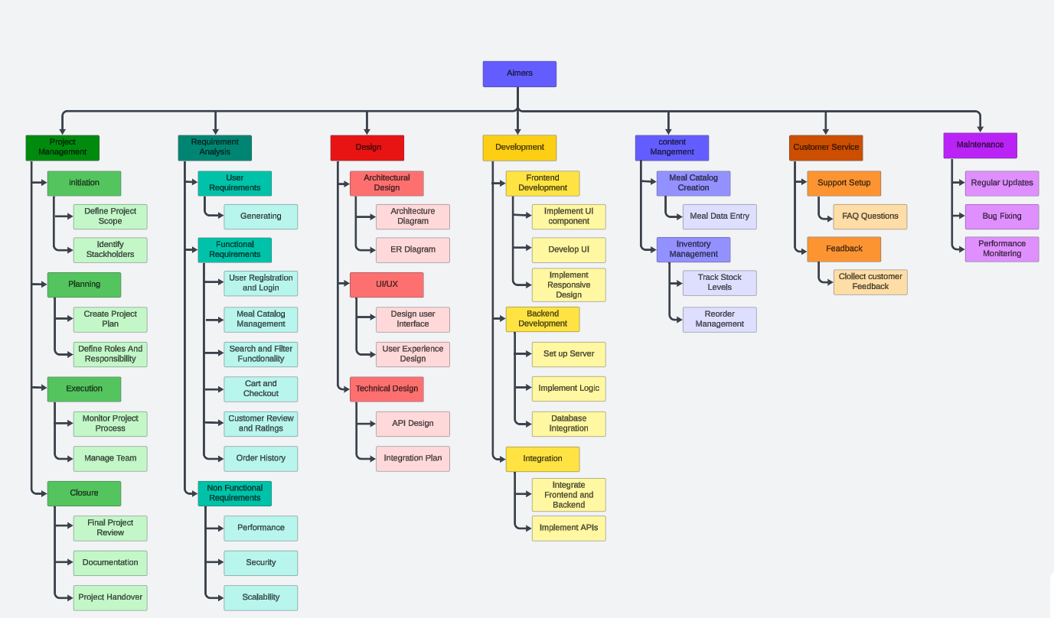
Workbreakdown structure

Slide 5
MULTI-STAGE MILESTONE CHART FOR INFLIGHT CATERING
MILESTONE 1
Planning and Requirements Gathering
MILESTONE 2
User Management Module
MILESTONE 3
Menu Management Module
MILESTONE 4
Order Management Module
Define project scope and objectives
11/06/2024
Develop menu item categorization
25/06/2024
Gather functional and non-functional requirements
14/06/2024
Create administrator approval workflow for menu items
28/06/2024
Create a detailed project plan and timeline
17/06/2024
Conduct unit testing and integration testing
01/07/2024
Design and implement user registration and login functionality
18/06/2024
Design and implement order placement functionality
02/07/2024
Develop user profile management
20/06/2024
Develop order viewing, editing, and cancellation functionality
06/07/2024
Conduct unit testing and integration testing
24/06/2024
Create order status updates
08/07/2024
STAGE 1
STAGE 2
STAGE 3
STAGE 4

Slide 6
MULTI-STAGE MILESTONE CHART FOR INFLIGHT CATERING
MILESTONE 5
Payment Gateway Integration
MILESTONE 6
Order Fulfillment Module
MILESTONE 7
Testing and Deployment
Integrate payment gateway
09/07/2024
Conduct system testing and integration testing
23/07/2024
Develop secure online payment processing
12/07/2024
Deploy the system to a cloud platform
Render
25/07/2024
Conduct unit testing and integration testing
15/07/2024
Set up environment for development, staging, and production
27/07/2024
Design and implement caterer dashboard
16/07/2024
reate customer order tracking functionality
18/07/2024
Conduct unit testing and integration testing
22/07/2024
STAGE 5
STAGE 6
FINAL STAGE

Slide 7
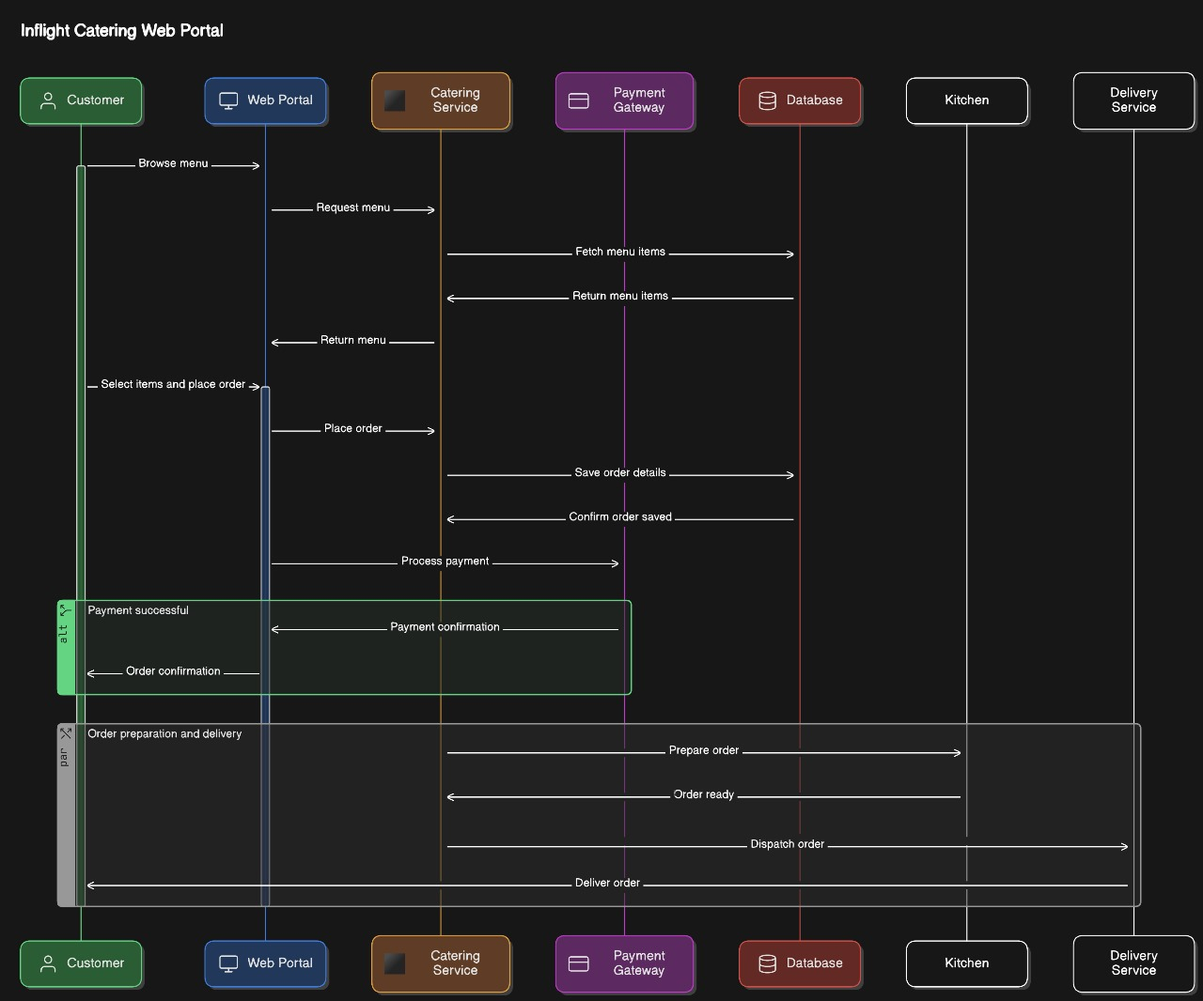
System Design / Architecture

Slide 8
System Requirements
Operating System: Windows, macOS, or Linux (Ubuntu, CentOS) are commonly used and supported.
Hardware: Processor: Intel Core i5 or AMD Ryzen 5 equivalent or higher.RAM: 8GB or higher for development, 16GB recommended for production.
Storage: At least 256GB SSD for faster disk operations.
Software: Node.js: Latest LTS version installed (includes npm).
MongoDB: Latest stable version installed.
React.js: Latest stable version.
Express.js: Latest stable version.
Redux (optional): For state management if needed.
Other dependencies: Any other libraries or packages specific to your project.
Development Tools: Integrated Development Environment (IDE): Visual Studio Code, Atom, or any IDE of your preference.
Git: Version control system for collaboration and code management.
Web Browser: Chrome, Firefox, or Safari for testing and debugging.
Network: Internet connectivity for downloading dependencies, accessing APIs, and testing online features.

Slide 9
Optional:
Docker: For containerization and deployment.
NGINX/Apache: For reverse proxy and serving static files in production.
CI/CD tools: Jenkins, Travis CI, CircleCI, for continuous integration and deployment.
Security Considerations:
SSL/TLS certificate: To secure communications over HTTPS.
Firewall configuration: To restrict access to the server and database.
Authentication and authorization: Implement user authentication and role-based access control.
Scalability Considerations (Kubernetes):
Load balancer: For distributing incoming traffic across multiple servers.
Horizontal scaling: Ability to add more servers to handle increased load.
Database sharding or replication: To distribute data across multiple servers for improved performance and fault tolerance.

Slide 10
Deliverables
Functional Deliverables
User Management Module: User registration and login functionality
User profile management (update, delete)
Administrator dashboard for managing user accounts
Menu Management Module: Menu item creation, editing, and deletion functionality
Menu item categorization (e.g., breakfast, lunch, dinner, snacks)
Administrator approval workflow for menu items
Order Management Module: Order placement functionality for customers
Order viewing, editing, and cancellation functionality for customers and administrators
Order status updates (e.g., prepared, delivered) by caterers
Payment Gateway Integration: Integration with a payment gateway (e.g., Stripe, Razorpay)
Secure online payment processing
Order Fulfillment Module: Caterer dashboard for managing orders
Order status updates by caterers
Location Tracking (GPS: e.g.,GCP [Google cloud] )
Rating and Review Module: Customer rating and review functionality for caterers and menu items
Caterer dashboard for viewing ratings and reviews

Slide 11
Deliverables
Non-Functional Deliverables
Performance Optimization: Optimized database queries for improved performance
Caching mechanism for frequently accessed data
Load testing and performance benchmarking
Security: HTTPS encryption for all transactions
Secure password storage using a hashing algorithm
Regular security audits and penetration testing
Usability and Accessibility: Responsive web design for desktop and mobile devices
Accessibility features for users with disabilities (e.g., screen reader compatibility)
User interface design guidelines and style guide
Scalability and Availability: Horizontal scaling architecture for handling increased traffic
Load balancing and auto-scaling configuration
Uptime monitoring and alerting system
Documentation and Testing: Technical documentation for developers (e.g., API documentation, code comments)
Unit testing, integration testing, and end-to-end testing
Test cases and test data for each module

Slide 12
Functional requirements
User Management: Third-party caterers can register and log in to the system.
Caterers can update their profile information.
Administrators can manage caterer accounts (e.g., approve, reject, or suspend).
Menu Management: Caterers can create, edit, and delete their menu items.
Menu items can be categorized (e.g., breakfast, lunch, dinner, snacks).
Administrators can review and approve menu items.
Order Management: Customers can place orders for menu items.
Orders can be viewed, edited, and cancelled by customers and administrators.
Caterers can view and manage their orders.
Payment Gateway: Integrate a payment gateway to process transactions.
Customers can make payments online.
Order Fulfillment: Caterers can update order status (e.g., prepared, delivered).\
Rating and Review: Customers can rate and review caterers and their menu items.
Caterers can view their ratings and reviews.

Slide 13
Non-Functional requirements
Performance: The system should respond to user requests within 2 seconds.
The system should handle a minimum of concurrent users.
Security: The system should use HTTPS encryption for all transactions.
Passwords should be stored securely using a hashing algorithm.
Usability: The system should have an intuitive user interface.
The system should be accessible on desktop and mobile devices.
Scalability: The system should be able to scale horizontally to handle increased traffic.
The system should be able to handle a minimum of registered users.
Availability: The system should have a minimum uptime.
The system should have a backup and disaster recovery plan in place.
Maintainability: The system should have a modular architecture for easy maintenance and updates.
The system should have a logging and error reporting mechanism.

Slide 14
List of all inputs
User Inputs: Registration Information (Name, Email, Password, etc.)
Login Credentials
Search Queries (for finding catering services, menus)
Order Details (flight details, meal preferences, dietary restrictions.)
Form Inputs: Registration Form Fields
Order Form Fields (flight details, meal preferences, quantity.)
Contact Form Inputs (name, email, message)
File Uploads: Menu Images (uploaded by caterers),User Avatars (profile pictures)
Supporting Documents (e.g., PDFs for catering contracts)
API Inputs: API Requests and Parameters (e.g., GET, POST, PUT requests)
JSON Payloads for data exchange with backend services
Authentication Tokens for accessing protected APIs
System Configuration Inputs: Database Configuration (connection strings, credentials)
Environment Variables (e.g., database URL, API keys)
Server Configuration (e.g., port numbers, hostnames)

Slide 15
List of all outputs
User Interface Outputs: Rendered Web Pages (home page, catering service listings, order forms)
Dynamic Content (menus, catering packages, user profiles)
User Notifications (success messages, error alerts)
API Outputs: JSON Responses to API Requests (catering service details, order confirmation)
Status Codes (200 OK, 404 Not Found)
Error Messages (in case of invalid requests or server errors)
File Downloads: PDF Menus (downloadable versions)
Order Confirmations (receipts, invoices)
Catering Contracts (downloadable agreements)
Email Outputs: Registration Confirmation Emails
Order Confirmation Emails
Password Reset Instructions
Marketing Newsletters (if opted in by users)

Slide 16
List of all outputs
Data Outputs : Database Records (user profiles, order details, catering service listings)
Aggregated Reports (sales reports, user statistics)
Exported Data (CSV, Excel files for analytics or accounting purposes)
Logging Outputs: Server Logs (HTTP request logs, error logs)
Database Logs (query logs, performance logs)
Application Logs (debugging information, exception traces)
Integration Outputs: Data Sent to External APIs (payment processing, mapping services)
Webhooks Triggered Events (notifications to external systems)
Third-party Service Outputs: Payment Confirmations (from payment gateway)
Mapping Directions (from mapping service)
Email Delivery Status (from email service provider)
System Status Outputs: Health Check Responses (indicating system status)
Maintenance Notices (if the system is temporarily unavailable)

Slide 17
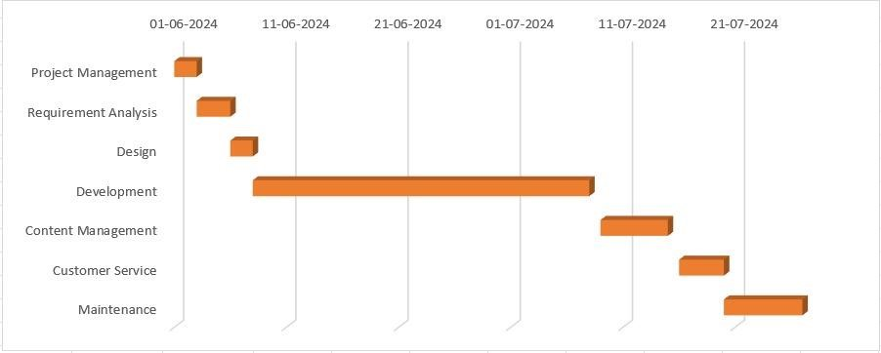
Schedule and Delivery plan
Figure
:
Gantt Chart

